Slide 2
Establishing New Organizational Units, Status Adjustments, and Naming Conventions
By Rowena J Moore
Notes:
I was asked to talk today about Establishing New Organizational Units, Status Adjustments, and Naming Conventions. Hopefully the presentation today will provide some insights into the importance of working with the Yearbook Office on all these matters.

Slide 3
The Inter-Connected Webs

Slide 4
Yearbook (AdmFieldID, OrgMastID)
GC Treasury
Adv Risk Management
SunPlus
MyReport
Education
Global Mission
Exchange Rates
Literature Evangelists
Membership
Tithes and Offerings
Notes:
First of all, some background and explanations which may be of help to you. When the Yearbook database was created in the late 1990s, it was created solely for the purpose of printing an annual book. But over time, some features of the Yearbook database, especially the AdmFieldID and OrgMastID began to be used by GC Treasury, Risk Management, and SunPlus. Last quinquennium it was agreed that the General Conference should begin moving towards a more centralized manner of managing databases worldwide. Now, under the direction of the office of the Chief Information Officers, the General Conference is focusing on the development of new systems that will link into some of the identifiers used in the Yearbook database.
MyReport, the web-based system for reporting quarterly and annual statistics, has already been created, and is being used by all divisions. Because MyReport uses the AdmFieldID and names of organizational units, if you have created new fields, or restructured or renamed current fields, and haven’t notified the Yearbook Office so I can implement those changes, you won’t see them reflected in MyReport.
Besides MyReport, reporting programs for Education, Exchange Rates, Global Mission, Literature Evangelists, Membership, and Tithes and Offerings have also been created. And work will continue over this quinquennium to link together the many reporting systems of the world Church so we can avoid duplication of work, and make it easier to work together.
I have mentioned that two identifiers of the Yearbook database, used by many other entities, are the AdmFieldID and OrgMastID. I want to give an explanation of these because most of you will either work with them or at least notice them in MyReport and other reporting systems.

Slide 5
AdmFieldID
Used by
Adventist Church Management System
Education
MyReport
Etc. by Italo Osorio
Central Nyanza Conference CNYF
German Swiss Conference GSWC
Greek Mission GRKM
South Bolivar Venezuela Mission SOBO
Southeast Sao Paulo Conference SESP
Southwest India Union Section KRLA
Notes:
This is a unique, usually four-letter code that the Yearbook Editor is responsible for creating or making up when a new organizational unit is created.
The AdmFieldID was designed to be an abbreviation/acronym-like ID. Initially it looked like that. But over time as the world Church grew, it wasn’t always possible to use an exact abbreviation/acronym for the org unit as there would have been duplicates. Remember, the AdmFieldID is a unique identifying code. In the last year or two, the AdmFieldIDs I have created may look a little different than the IDs created in the past. One very important thing to know: the AdmFieldID assigned at the time a field is created will never change – regardless of the change of status (i.e., from mission to conference), the change of name, or the change of the parent organization.
Here are a few examples of AdmFieldIDs, some of them created years ago, and others created just within the last year or two.
You will notice that some AdmFieldIDs above look almost like acronyms, and others do not.
The AdmFieldID is used by the Adventist Church Management System, Education, MyReport, and the various reporting systems Italo Osorio is creating here at the General Conference.

Slide 6
OrgMastID
Used by
GC Treasury
SunPlus
Adventist Church Management System
ARM
Adventist
Inter-American Division AG1111
Cuban Union Conference AGD111
Central Conference AGD611
Del Amancer Conference AGD911
Division Identifier
Union Identifier
Local Field Identifier
Common to all Org Units
Notes:
The OrgMastID is a six-digit alphanumeric ID automatically calculated by the Yearbook/Adventist Directory database when a new organizational unit is created. It provides a hierarchical structure or identifier for each organizational unit and institution that is created in the database.
Here is an example of the Inter-American Division, one of its unions, and two of its local fields:
In the OrgMastID, the A stands for Adventist, the G identifies the Inter-American Division, the third digit, in this case, the D, stands for the Cuban Union, and the fourth digit, 6, and 9 above, stands for the local fields. For all organizational units, the last two digits are 11. The OrgMastID of institutions utilizes those last two digits.
If at some point the Cuban Union split into North and South Cuban Unions, we would ask the division if they wanted the original Cuban Union to be retired (rather than be reused for one of its “replacements”), and two new unions created; or, if they wanted us to rename the original Cuban Union one of the new names (normally the name of the union that would be headquartered in the old Cuban Union office), and then create one new org unit. This question is very important because if the original union is retired, the OrgMastID of AGD111 will also be retired. Some divisions/unions prefer to keep the original OrgMastID, and others want a clean start, and will request that two new unions, and OrgMastIDs be created.
OrgMastIDs change whenever the parent organizational unit changes, because it represents the hierarchical order or placement of the field. If the former Cuban Union is renamed, it keeps its OrgMastID, and so do the local fields that stay under it! The local fields moving to a new union will have new OrgMastIDs because they have a new organizational parent.
The OrgMastID is used by GC Treasury, ARM, SunPlus, and Adventist Church Management System.
With this background, let me focus now on the three areas I was asked to cover.

Slide 7
Essential Data for a New Organizational Unit

Slide 8
Timing and Order of Notification
New fields cannot be processed in MyReport and other databases until the Yearbook first creates their OrgMastID and AdmFieldID – so notify me of new fields as soon as possible.
If you want new fields to report their statistics in MyReport for the quarter in which they begin functioning, you should send their information to the Yearbook Office within the same quarter the changes are to become effective. Once MyReport has been closed for that quarter, the new or reorganized org unit may not be able to report their statistics until the following quarter.
Notes:
I explained above that your new and reorganized fields will not be able to send their information into MyReport or most of the other databases here at the GC that use the OrgMastID or AdmFieldID until the Yearbook database has been updated first.
So it is vital that you notify us of new fields and reorganized fields as soon as possible. If you want those fields to report their statistics in MyReport for the quarter in which they begin functioning, you should send the Yearbook Office your division actions and the information outlined below no later than the same quarter the changes are to become effective. IF the changes come too late, and MyReport has been closed for that quarter, the new or reorganized org unit may not be able to report their statistics until the following quarter.

Slide 9
Send us...
A copy of the division action, including the date of that action
The name as you want it to appear in the Yearbook and other databases
The date the new org unit will begin operating
Notes:
What does the Yearbook Office need in order to create the new fields?
■ A copy of the division action, and the date the action was voted.
■ The names of the new fields as you want them to appear in the Yearbook. (Organizational units usually have “English names,” even though they may be known by something else within their own division or language group. Please consider looking carefully at the names of the new and revised fields before voting them. There have been quite a few cases where unions thought the name of a new field was one way, the division voted it a different way, and I am sent both names, and there is confusion. There have
also been cases where I have created the new fields as per the division action, and then the division changes the names of the fields shortly after. This creates extra work for me, and for those entities that I have already advised of the new fields.)
■ The actual date the new or reorganized fields will begin operating – such as February 1, 2016 or December 31, 2016.

Slide 10
For rush Yearbook inclusion of end-of-year actions send...
Everything listed on the last slide
A specific territory description
Contact information (Phone, Fax, E-mail, Website, Address)
Administration – at least the officers
Departments and Directors if you have them
Notes:
If you have taken these actions at your Year-end meetings, and the new fields are going to begin functioning immediately, or before February 1, and you want the new fields to be included in the next Yearbook, that can be done, but only if you send me the information above, and also:
■ A specific Territory description of the new or reorganized field
■ Contact information (Phone, Fax, E-mail, Website, Address)
■ Administration – at least the officers
■ Departments and Directors if you have them; otherwise they can be added the following year

Slide 11
Notice of new OrgMastID and AdmFieldID
Division’s Officers
Italo Osorio
Kathleen Jones
Relevant GC Associate Secretary
Adventist Church Management System
SunPlus
Notes:
After I create or reorganize the fields, I send a notice out, including the OrgMastID and AdmFieldID of the new and reorganized fields, to:
The division’s officers
Italo Osorio
Kathleen Jones
The GC associate secretary working with that division
Adventist Church Management System
SunPlus

Slide 12
Name or Status Changes

Slide 13
Send us...
The division action, and the date it was voted
The effective date of the name change
NO Yearbook Update
NO Update Elsewhere
Notes:
The name change of an established field (i.e., Cabo Mission becomes Greater Cabo Mission); or a status change of a field – a region becoming a mission; a mission becoming a conference – must again be sent to the Yearbook Office as soon as possible after the division votes the change. Again, we will need the following information:
■ A copy of the division action, and the date the action was voted.
■ The effective date of the name change – in some cases it may be effective as soon as the division votes it; in other cases it may have a different effective date.
Until the change has been made in the Yearbook database, that name change or status change will not be reflected in any of the systems using the OrgMastID or AdmFieldID, including MyReport, Adventist Church Management System, and SunPlus!
After I rename the field, or revise the status of the field, I send a notice out, including the OrgMastID and AdmFieldID of the fields, to the same individuals/offices listed above.

Slide 14
What to Call the New Org
Notes:
Although you are dealing only with the fields in your division, the Yearbook office works with all 13 divisions (and approximately 760 other organization units worldwide). As the Church continues to grow, it is perhaps understandable that more and more field names are quite similar, and in some cases, duplicates of names in other divisions. Some examples:
a. There are currently two Central Conferences, and a Central Mission. If the mission becomes a conference at some point, we will have three Central Conferences. We also have two West Conferences. These are generic, non-specific names that tell us nothing about the fields or the part of the world they are in.

Slide 15
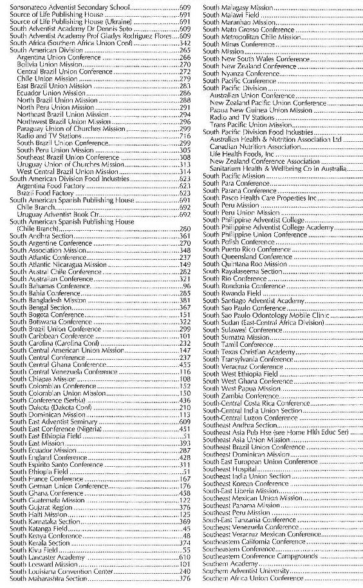
Avoid Directional Names
Notes:
b. It seems that directional names are the most popular as part of field names. But those names can become challenging for a couple of reasons. First, we already have directional names such as North East, North-East, Northeast, South East, Southeast, South-West, and Southwest. Whether they are two words (North East), a hyphenated word (North-East), or a combined name (Northeast) can sometimes change the alphabetical placement of that field within its division or union.
c. In one country that has been split into two unions, the fields are named:
Central East ___
Central ___
East ___
North Central ___
Northwestern ___
South Central ___
Southeast ___
West Central ___
West ___
Can you see the possibility of confusion?
Right now we have 68 fields that begin with Central, and 48 fields that begin with the word West.
d. The second problem the directional names create for us is that in the employee credentials section of the database, we use dropdown windows to select the correct organizational unit; unfortunately, there are times we have accidently selected the wrong entity out of a long list of names beginning with Central, East, North, or South.
e. We also have at least two places where there is a union and conference with the same name, except for the word, Union, and this can be confusing at times. (Substituting a made-up name, here is an example of one of these situations):
Central Rainbow Union Conference
Central Rainbow Conference (the conference is not in the Central Rainbow Union Conference)

Slide 16
Please DO:
Be very intentional about the name you vote
Check the Yearbook General Index to see if the name you are considering is already in use
Encourage unique names that don’t use directional words
Send us division actions renaming, reorganizing, or creating fields as soon as possible after the vote
Review GC Working Policy B 10, Outline and Definitions of Denominational Organization, which was revised a two or three years ago
Notes:
Some Suggestions
1. First of all, from the union to the division, please be very intentional in determining the names of new fields. Try to be sure that what you vote is what the name of the field should actually be so that the information sent to the Yearbook Office is correct, and won’t have to be changed one or two times because someone thought of a better name.
2. If you are thinking of naming a field and wondering if the name already exists or it might be lost in a long list of similarly named fields, you can check the General Index in the back of the printed Yearbook before you actually vote a name.
3. Please encourage your unions to consider non-generic and non-directional names for their new fields. A unique name for a new field is always preferred, using factors such as:
a. the name of the province, state or country the field is located in (if the entire territory of the state/country is in the field) – Armenian Mission, Baja California Conference, Edo Conference, French Polynesia Mission, Reunion Conference, Romblom Adventist Mission, etc.
b. a name tied to a geographical area, language, or site in the field – Chesapeake Conference, French-Italian Swiss Conference, Greater Rift Valley Conference, Tiza Conference.
4. Please send us copies of your division actions renaming, reorganizing, or creating fields as soon as possible after the vote. Even if the effective date is several months ahead, we will be aware of what is coming, and not be caught off guard.
And on a final note, please review GC Working Policy B 10, Outline and Definitions of Denominational Organization, which was revised a two or three years ago. Notice the two new organizational units now included in policy, Field Station, and Region, and their criteria. Please make sure that any new organizational units your division is creating or reorganizing meet the requirements of GC policy.

Slide 17
Questions?
Notes:
Conclusion
I know that sometimes with my insistence on specific information from the fields, I may seem like a nuisance at times. But from my office I can see the overall picture, and I need your information so I can do the best job possible in not only putting out an annual Yearbook; but so the divisions and the other entities using or tied into the Yearbook database can function to the best of their ability.
Do you have any questions I can try and answer in the time we have left?
Thank you for your time today. I look forward to getting better acquainted with some of you either thru future e-mails or during the ASTR Advisory.

